Slide 1
ReportIt
Project Developers:
Ethan Azizov
Roei Shriki
Moisey Moiseev

Slide 2

Main Idea
Many municipalities struggle with slow and inefficient hazard reporting, leading to delays in fixing issues like potholes and broken streetlights.
Our solution is a mobile app that allows citizens to report hazards easily, while a web platform enables municipalities to manage and resolve them efficiently. This improves communication, speeds up response times, and enhances urban safety.

Slide 3
Programming Languages and Development Environment
Environments:
ANDROID STUDIO
Visual Studio
FIRESTORE
Languages :
JAVA
C#
JavaScript
HTML
CSS

Slide 4
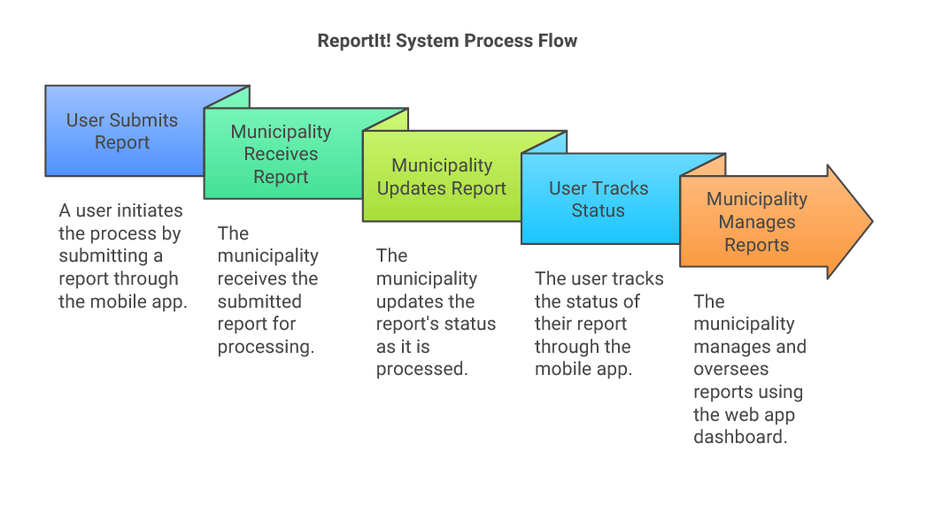

Slide 5
User roles in web application
• Admin: Grants permissions, creates users.
• Municipality Manager: Supervises, manages handlers.
• Municipality Handler: Reviews, updates, and manages reports.

Slide 6

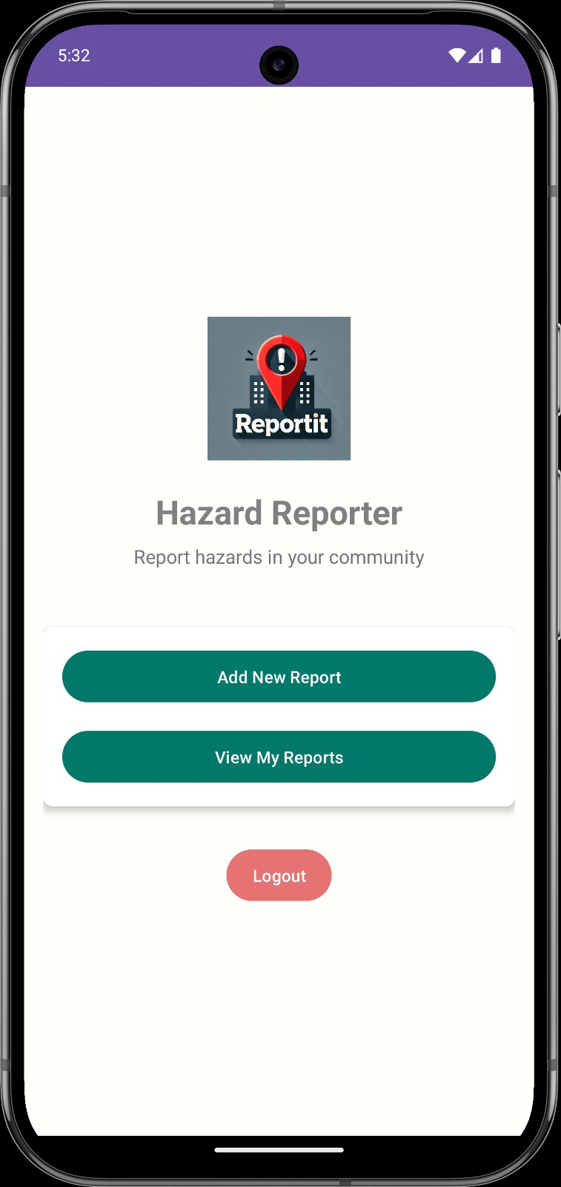
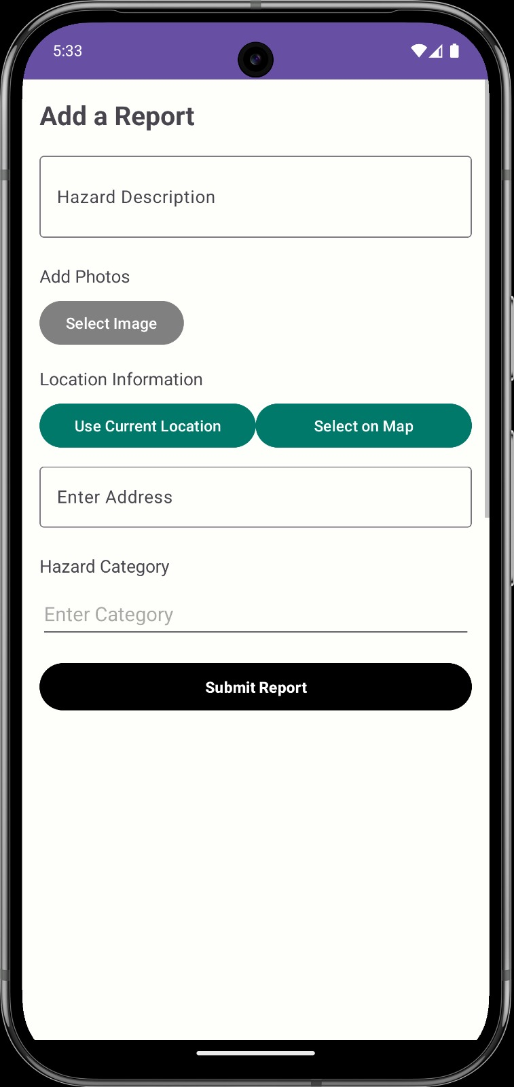
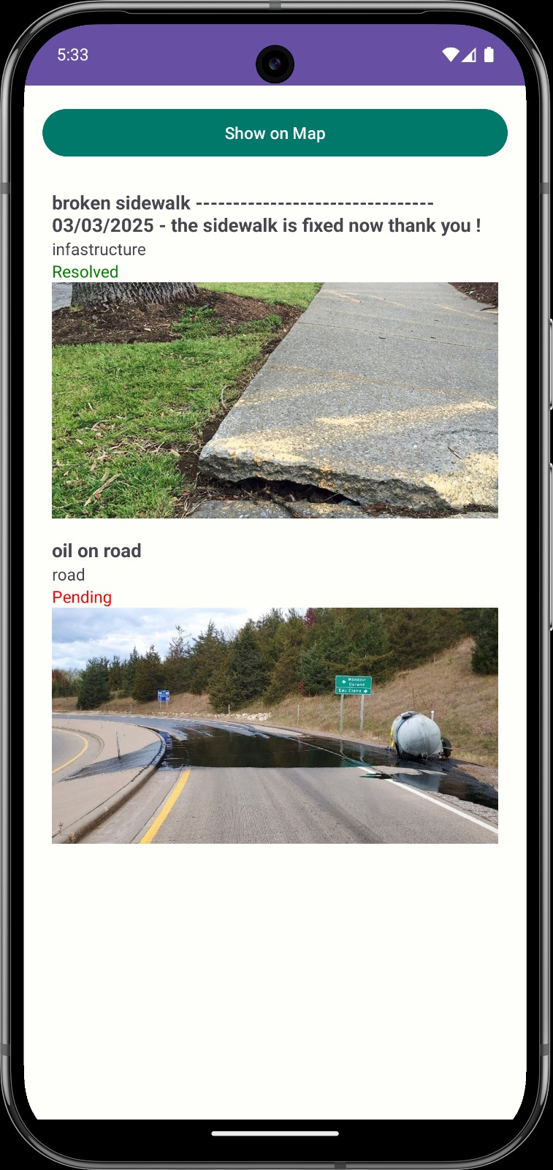


Slide 7

The end

